Slide 1
Family Papillomaviridae
Papillomatosis
Notes:
Originally, PVs were grouped with the polyomaviruses in the family Papovaviridae,

Slide 2
INTRODUCTION
Non-enveloped with circular double-stranded DNA
Baltimore group I
Highly host-and tissue-tropic,
All known papillomavirus types infect a particular body surface, typically the skin or mucosal epithelium of the genitals, anus, mouth, or airways
Replicate exclusively in the basal layer of the body surface tissues.
Produce proliferative lesions or warts in many mammalian and avian species.
Have not been cultured in vitro
Notes:
1935 Francis Peyton Rous, who had previously demonstrated the existence of a cancer causing sarcoma virus in chickens, went on to show that a papillomavirus could cause skin cancer in infected rabbits. This was the first demonstration that a virus could cause cancer in mammals.

Slide 3
The Papillomaviridae family includes two subfamilies, the First papillomavirinae and the Secondpapillomavirinae.
The Firstpapillomavirinae currently contains 51 genera while only one genus is currently classified within the Secondpapillomavirinae subfamily.
Genera in the Firstpapillomavirinae are named using the Greek alphabet (Alpha-, Beta-, Gamma-, Deltapapillomavirus, etc., and derivatives thereof, eg, Dyodeltapapillomavirus)

Slide 4
Within genera, the papillomaviruses are further subdivided into numerically-named species. Currently there are 133 papillomavirus species within the 51 papillomavirus genera.
Within the species, papillomaviruses are subclassified into individual papillomavirus types. Each papillomavirus type is named sequentially using the scientific name of the host species.
Around 500 individual papillomavirus types have been fully classified, including around 175 from the non-human species.
Each animal species may be infected with multiple genetically distinct papillomavirus types that are included in different genera.

Slide 5
Important species causing disease in animals
  BPV-Bos taurus papillomavirus;
  OaPV, Ovis aries papillomavirus;
  EcPV, Equus caballus papillomavirus;
  CPV, Canis familiaris papillomavirus;
  FcaPV, Felis catus papillomavirus

Slide 6
Species | Papillomavirus genus | Papillomavirus types | Predominant associated lesions
Cattle | Delta | BPV-1, -2, -13, -14 | Cutaneous and esophageal fibropapillomas
 |  |  | Bladder neoplasia
 | Xi | BPV-3, -4, -6, -9, -10, -11, -12, -15, -17, -20, -23, -24 | Cutaneous and upper alimentary papillomas
 | Epsilon | BPV-5, -8 | Cutaneous papilloma
 | Dyoxi | BPV-7 | Cutaneous papilloma
 | Dyokappa | BPV-16, -18, -22 | Cutaneous papilloma
 | Unclassified | BPV-19, -21 | Cutaneous papilloma
Sheep | Delta | OaPV-1, -2, -4 | Cutaneous fibropapilloma
 | Dyolambda | OaPV-3 | Cutaneous SCC
Horses | Zeta | EcPV-1 | Cutaneous papilloma
 | Dyoiota | EcPV-2, -4, -5 | Penile papilloma
 |  |  | Aural plaque
 | Dyorho | EcPV-3, 6, 7 | Aural plaque
 | Unclassified | EcPV-8 | Cutaneous papilloma
 | Delta | BPV-1, -2, 13 | Equine sarcoid
Dogs | Lambda | CPV-1, -6 | Oral papillomas
 |  |  | Cutaneous papillomas
 | Tau | CPV-2, -7, -13, -17, -19 | Cutaneous papillomas
 | Chi | CPV-3, -4, -5, -8, -9, -10, -11, -12, -14, -15, -16, -18, -20 | Viral pigmented plaques
Cats | Lambda | FcaPV-1 | Oral papillomas
 | Dyotheta | FcaPV-2 | Viral plaques/BISC
 |  |  | Cutaneous SCC
 | Unclassified | FcaPV-3, -4, -5 | Viral plaques/BISC
 | Delta | BPV-14 | Feline sarcoid

Slide 7
Papillomaviruses can be categorized according to their tissue tropism and the lesions that they cause.
The vast majority of papillomaviruses only infect keratinocytes and induce a squamous cell papilloma comprised of thickened folded epithelium.
In contrast, the deltapapillomaviruses of ruminants infect and cause proliferation of both keratinocytes and the underlying fibroblasts to produce fibropapillomas.
While these papillomaviruses are able to infect both epithelial and mesenchymal cells, productive virus replication is restricted to the epithelial component of fibropapillomas.

Slide 8
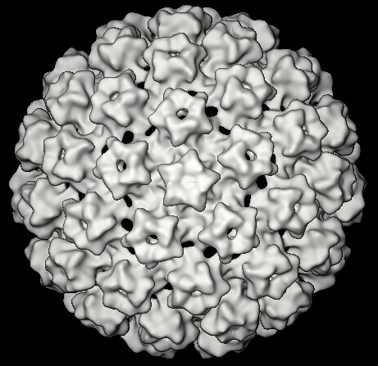
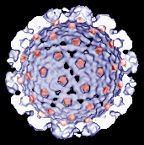
Papillomavirus Virion
Non-enveloped
60 nanometer diameter
Two capsid proteins L1 and L2
Icosahedral shell formed by 72 star shaped capsomeres (12 pentons and 60 hexons) of mostly protein, L1

Slide 9
Genome
8 kilobase
circular dsDNA associated with cellular histones in a chromatin-like complex.
Persists as episome (doesn’t integrate into cellular DNA)
Virus uses overlapping genes on one strand to pack different genes
E6
E7
7904/1
L1
7000
1000
6000
2000
E1
5000
3000
E4
L2
4000
E5
E2

Slide 10
GENE EXPRESSION
Only one strand of the genome is transcribed and yield two classes of proteins expressed by alternative splicing :
a) Early Proteins: non-structural regulatory proteins (E1-E7).
b) Late Proteins: the structural proteins L1 and L2.
Notes:
Constitutive splicing is the process of intron removal and exon ligation of the majority of the exons in the order in which they appear in a gene. Alternative splicing is a deviation from this preferred sequence where certain exons are skipped resulting in various forms of mature mRNA. A mechanism by which different forms of mature mRNAs (messengers RNAs) are generated from the same gene.

Slide 11
Various proteins coded by Papilloma viruses
E1- Helicase (Helps in virus replication)
E2- Transcriptase (Helps in viral replication)
E4- Destabilizes cytosleleton
E5- Mediates mitogenic signals
E6- Cell transformation (binding to p53)
E7- cell transformation (binding to pRB)
L1- Major capsid protein
L2- Minor capsid protein

Slide 12
REPLICATION
Site-Nuclear
Replication is divided in two distinct steps that are linked to the differentiation state of the host epithelial cell:
The plasmid replication takes place in the basal squamous epithelial cells.
It corresponds to viral DNA replication in synchrony with the host cell chromosome in order to ensure an average of one viral genome per basal cell.

Slide 13
Attachment of the viral proteins to host receptors mediates endocytosis into vesicles in the basal squamous epithelial cell.
Transport to the nucleus and uncoating of the viral DNA.
Early-region transcription with the help of DNA dependent RNA polymerase early transcription occurs and translation of the early proteins
Steady-state viral DNA nuclear replication.
At this stage, expression of viral capsid proteins cannot be detected.

Slide 14
b) The vegetative replication, which occurs in differentiated keratinocytes.
In these cells, which no longer undergo cellular DNA synthesis, there is a burst of viral DNA synthesis with active production of virions.
Vegetative viral DNA synthesis.
Transcription of the late region.
Capsid proteins L1 and L2 synthesis.
Nuclear capsid assembly and release of viruses.

Slide 15
PATHOGENESIS
Papillomas develop after introduction of the virus through skin abrasions.
In the cells of stratum germinativum virus proliferate excessively.
Early proteins delay the maturation of the cells and there is hyperplasia of basal cells.
There is piling of the cells.
Slowly differentiation starts and late proteins are expressed in stratum spinosum and complete virus particles are seen in the cells of stratum granulosum.
Infection of epithelial cells result in hyperpalsia of cells of the surface epithelium with subsequent degeneration and hyperkeratinization.

Slide 16


Life Cycle - Initial Infection (Skin)
virions
micro-trauma
Epidermis
(Keratinocytes)
Basal
Cells
Basement
Membrane
Dermis
Slide courtesy M. Kast

Slide 17
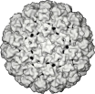
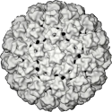
Gene Expression (Wart)
Progeny virions
Viral Proteins
Capsid &
Early
Epidermis
Early only
Basement
Membrane
Dermis
None

Slide 18
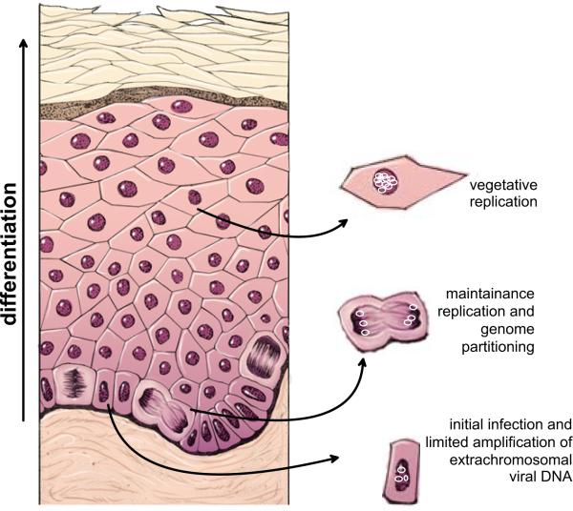

Slide 19
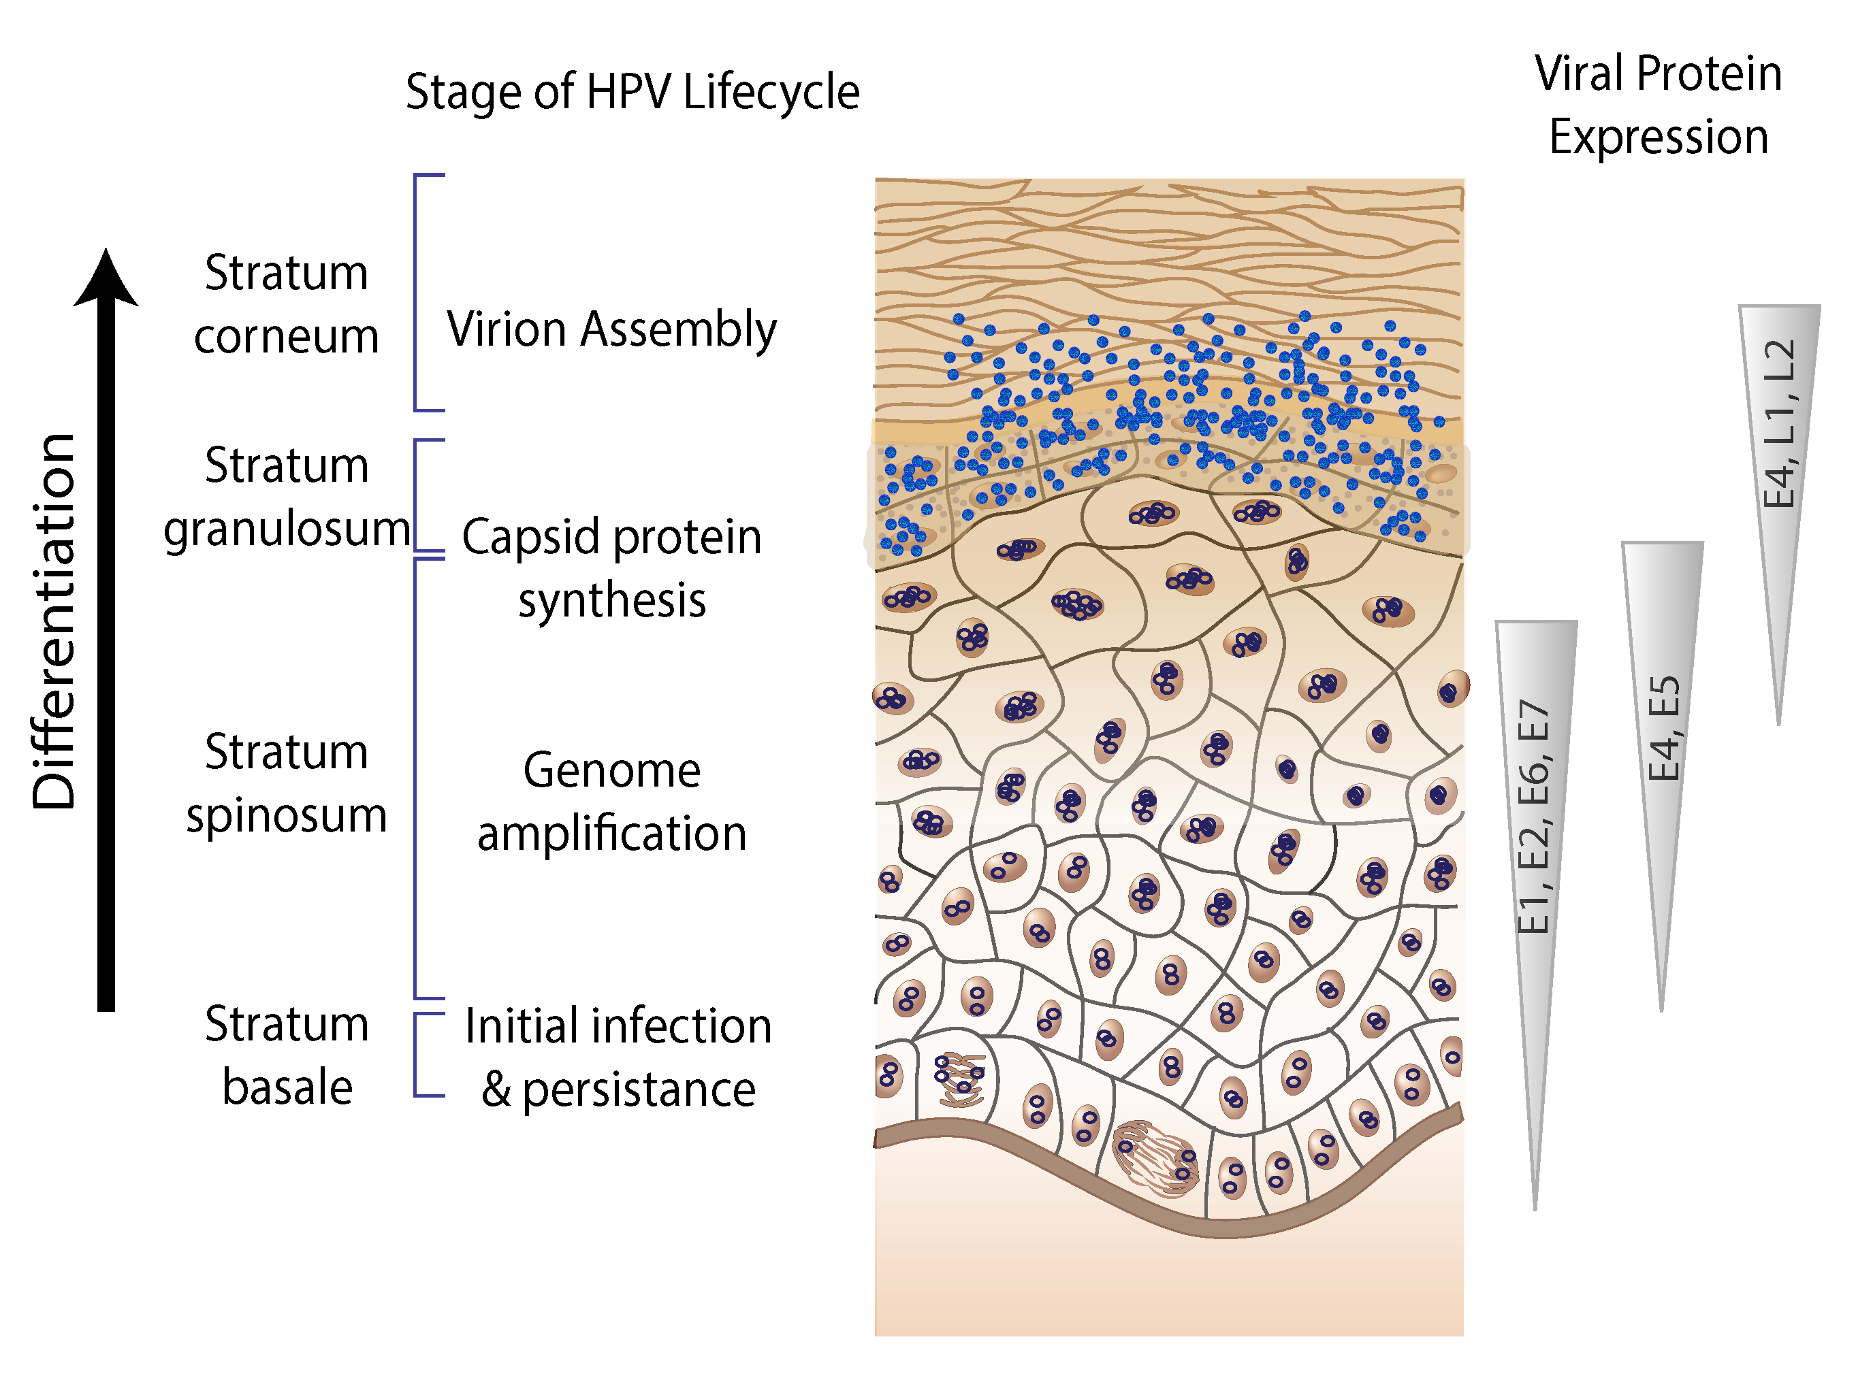

Slide 20
Maintenance and latency
After successful infection of a keratinocyte, the virus expresses very low levels of the early viral proteins E1 and E2, which are responsible for replicating and maintaining the viral DNA as a circular episome.
The viral oncogenes E6 and E7, which promote cell growth by inactivating the tumor suppressor proteins p53 and pRb, respectively, may also be expressed at very low levels.
Keratinocyte stem cells in the epithelial basement layer can maintain papillomavirus genomes in a dormant or "latent" state for decades.

Slide 21
Bovine papilloma virus (BPV)
BPV cause both benign and malignant epithelial and mesenchymal tumors or warts in cows and equids.
They are strictly species-specific and, even in experimental conditions, do not infect any other host than the natural one.
The only known case of cross-species infection is the infection of horses and other equids by BPV type 1 (BPV-1) or BPV type-2 (BPV-2)
To date, a variety of different papillomavirus types (n = 25) from five genera (Delta-, Dyoxi-, Dyokappa-, Epsilon-, and Xipapillomavirus) have been identified from clinical specimens obtained from cutaneous or mucosal epithelial lesions from infected cattle

Slide 22
Six BPV types (BPV 1-6) have been characterised associated with different histopathological lesions and classified into three groups:
Xi-papillomaviruses encompassing the pure epitheliotropic BPV-3;BPV-4 and BPV-6;
BPV-3 infects skin
BPV-4 infects the upper alimentary tract
BPV-6 infects teats and udders

Slide 23
Delta papillomaviruses encompassing BPV-1 and BPV-2 associated to fibropapillomas (i.e. benign tumors of both epithelium and underlying derma) and
BPV-1 infects paragenital areas, including penis, teats and udders
BPV-2 infects skin, alimentary canal and urinary bladder
Epsilon-papillomavirus comprising the BPV-5 whose genome seems to share similarities with the formers two BPV groups.

Slide 24
PATHOLOGY
Cutaneous warts are most common in younger animals (under 2 years) and usually spontaneously regress due to the animal's immune response without significant scarring.
Warts caused by the Xipapillomavirus group have a cauliflower-like appearance and can attain the size of a fist; most common on the head, neck and shoulders, they may also occur in other locations.

Slide 25
Cutaneous fibropapillomas - caused by Deltapapillomavirus group have a nodular appearance
The most common lesion in dairy cattle is the flat “rice-grain” fibropapilloma caused by BPV5
Warts are contagious and spread primarily by milking machines and milkers’ hands that carry the virus, which then infects the skin in areas of abrasion.

Slide 26
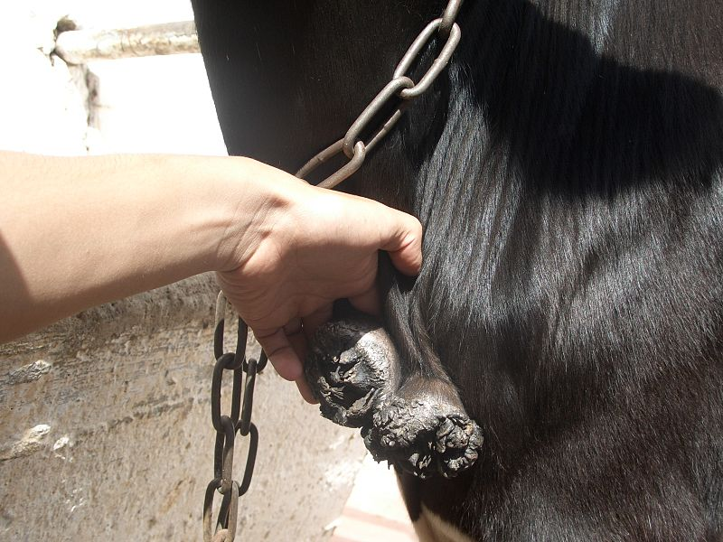
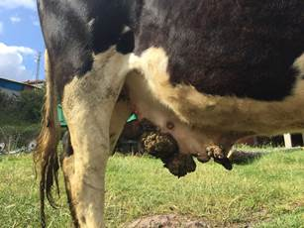
Large warts, showing the cauliflower-like appearance

Slide 27
Equine sarcoid
The sarcoids are benign tumors of fibroblastic skin origin affecting horses, mules and donkeys. They are locally invasive often occurring at sites of previous injury or scarring.
Most common tumour in equids worldwide
Clinically, six different types of sarcoids can be distinguished:
Occult sarcoid: is an hairless circular area of the skin;
Verrucous: tumors with wart-like appearance;
Fibroblastic sarcoids present as a fleshy mass;

Slide 28
Nodular sarcoids consist of firm masses lying under the skin and
Mixed sarcoid show a combination of features of verrucous, fibroblastic and nodular types
Malevolent sarcoids are the most infrequent form and are aggressive, invasive tumours that proliferate rapidly and may spread along fascial planes and vessels
Common sites of appearance is the skin of the head, ventral abdomen, legs and the paragenital region .
Both BPV-1 and BPV-2 have been detected in sarcoid tumours with the BPV-1 being the predominant type

Slide 29
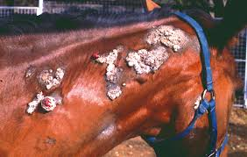
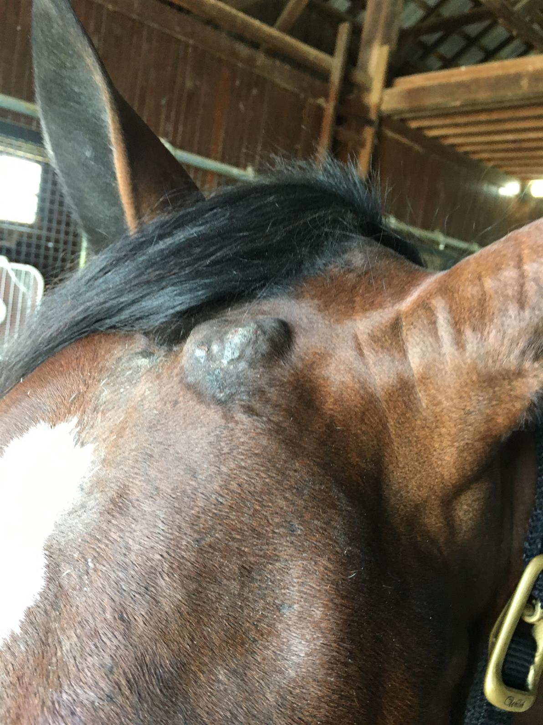

Slide 30
Diagnosis
By histopathology, thus a biopsy sample is needed (excisional biopsies).
BPV DNA can be detected by in situ hybridization and PCR on formalin fixed and paraffin embedded tissue sections of biopsy samples

Slide 31
Family Circoviridae

Slide 32
The family's name, "circo," is derived from the Greek root "gyro," which means ring or cirular. This refers to the characteristic circular shape of the circovirus genome
The family Circoviridae is comprised of viruses with circular, covalently closed, single-stranded DNA (ssDNA) genomes, including the smallest known viral pathogens of animals.
Baltimore group II
Genera in the Family: Circovirus and Cyclovirus
Members from the genus Circovirus mainly restricted to vertebrate hosts, whereas cycloviruses have been identified in both vertebrates and invertebrates

Slide 33
The genus Circovirus includes beak and feather disease virus, canary circovirus, goose circovirus, pigeon circovirus, duck circovirus, finch circovirus, gull circovirus, and porcine circoviruses 1 and 2.
Porcine circovirus 1 is the type species of the genus Circovirus
Psittacine beak and feather disease virus and porcine circovirus are 17 nm in diameter and are the smallest viruses of vertebrates known.
Chicken anemia virus (Gyrovirus) is 22 nm in diameter.
Characteristically, virions often appear in infected cells and in diagnostic specimens in rather stable linear arrays "strings of pearls."

Slide 34
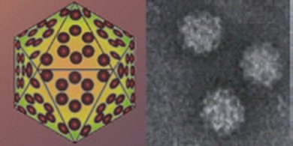
Virion morphology
Small, 17-22 nm in diameter.
Non-enveloped viruses with icosahedral nucleocapsids.
The capsid consists of 12 pentagonal trumpet shaped pentamers

Slide 35
GENOME
Non-segmented and single-stranded DNA, in the shape of a covalently-closed circle.
The genomic DNA is made up of 1800-2000 nucleotides.
Psittacine beak and feather disease virus and porcine circovirus employ an ambisense transcription strategy, i.e., ORFs are transcribed in opposite directions from a single promoter site.
Chicken anemia virus genes are all encoded in the positive-sense strand.
Viral replication occurs in the nucleus and depends on cellular proteins produced during the S phase of the cell cycle.

Slide 36
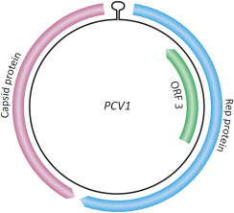

Slide 37
REPLICATION
Virus penetrates into the host cell.
Uncoating, the viral ssDNA genome penetrates into the nucleus.
Viral ssDNA is converted into dsDNA with the participation of cellular factors. dsDNA transcription gives rise to viral mRNAs.
Viral mRNAs are translated to produce viral proteins.
Replication may be mediated by a Rep protein, and occur by rolling circle replication producing ssDNA genomes.
These newly synthesized ssDNA can either
a) be converted to dsDNA and serve as a template for transcription/replication
b) be encapsidated by the capsid proteins and form virions released from the cell by budding.

Slide 38
Rolling circle replication
The ssDNA virus is converted to transcriptionally active, covalently closed circular DNA by host DNA polymerase
The Rep protein expressed from the viral genome cleaves at specific sites (origin of replication v-ori) at the virion strand to produce replicative form of DNA.
The free 3′ OH end is used by host DNA polymerase to synthesize the new strand using the circular strand as template.
As the new strands are synthesized, old strands are progressively displaced, after one or two circles, the old displaced strands are ligated to yield circular ssDNA virion strands.
The circularized new strands are either encapsidated or converted into replicative forms to enter another round of replication

Slide 39
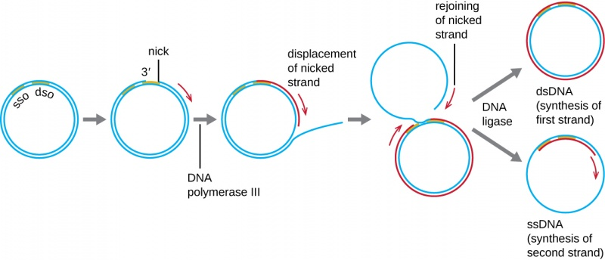

Slide 40
Chicken Anemia virus
Chicken Infectious Anemia, Blue Wing Disease
Non-enveloped, icosahedral virus with a very small (2.3 kb), single-stranded, negative sense, circular DNA genome, is the only recognized member of the Gyrovirus genus of the Anelloviridae family.
It was previously classified as a Circovirus, but important differences in genome organization led to its reclassification into the new Anellovirus family.

Slide 41
Introduction
Chicken anemia virus genome has three overlapping open reading frames,
VP1 major capsid protein- vital role in the growth and transmission of CAV
VP2 non-structural protein with phosphatase activity that plays a key role in the virus’s assembly during the infectious cycle.
VP3 apoptin protein which induces apoptosis of T lymphocytes. It induces severe lympho-atrophy and anemia in infected chickens, and can trigger apoptosis independent of p53 activation

Slide 42
Chickens are the natural hosts of CAV.
CAV has also been isolated from other species such as turkeys and CAV antibodies have been detected in quails.
CAV mainly infects 10–14 days-old chickens (less than two weeks old), leading to severe anemia, yellow bone marrow, aplasia of the bone marrow and atrophy of the lymphoid organ by damaging erythroblastoid cells, resulting in depletion of thymocytes, which makes the chickens immunodeficient .
It causes atrophy of the thymus and bone marrow, which also causes immunosuppression and weight loss in 2–4 weeks-old chicks.

Slide 43
The importance of this virus comes from its:
  Trans-ovarian transmission (vertical) and Horizontal transmission
  Potential for inducing immunosuppression alone or in combination with other infectious agents.
  All Chicken Anemia Virus isolates belong to one serotype

Slide 44
Transmission
CAV is highly contagious and it takes few weeks to spread through an entire flock.
Disease usually occurs during the first 3 week of life through;
  Vertical transmission.
  Contact exposure close to hatch.
Chickens at any age are susceptible to infection by:
  Oral route.
  Respiratory route.

Slide 45
TRANSMISSION
Horizontal transmission is through inhalation or oral exposure, and virus is shed in feces and feather dander.
Breeder flocks may become infected before they begin to lay fertile eggs, and virus subsequently is transmitted vertically for as long as the hen is viremic.
If hens are seropositive, maternal antibody generally protects chicks from disease.
Many flocks of otherwise specific-pathogen-free (SPF) chickens carry chicken anemia virus, and it is often difficult to eradicate the virus once it is present.

Slide 46
The principal sites of CAV replication are hemocytoblasts in the bone marrow, precursor T cells in the cortex of the thymus, and dividing CD4 and CD8 T cells in the spleen.
Replication in and destruction of the hemocytoblasts leads to anemia, whereas replication in and destruction of the T cells causes immunosuppression.
Under experimental conditions, the virus is found present in most organs after one day (brain, liver, spleen, bursa, bone marrow, rectal contents and serum).
Morbidity and mortality rates are high dependent on the age of the chickens when infected

Slide 47
Clinical Signs
Young chickens are depressed and huddle under the heat source.
Exhibit a marked pallor that may extend to the internal organs.
In chicken anemia virus-infected chickens with severe anemia, hemorrhagic-aplastic anemia syndrome as characterized by intracutaneous, subcutaneous, and intramuscular hemorrhages with the wing tips frequently affected, can also occur (blue wing disease)
The bone marrow is pale or yellow in color and may have a fatty consistency.

Slide 48
5. Thymic atrophy and congestion is common and is considered diagnostic when associated with other typical signs or lesions.
Bursal atrophy is generally modest and transitory, typically occurring at 10 to 14 days of age in chickens vertically infected.
All of the aforementioned lesions are exacerbated and more persistent in chickens coinfected with infectious bursal disease virus or other lymphocidal agents.
Severely affected birds generally die within 2 to 4 week of age
Survivors are often stunted.

Slide 49
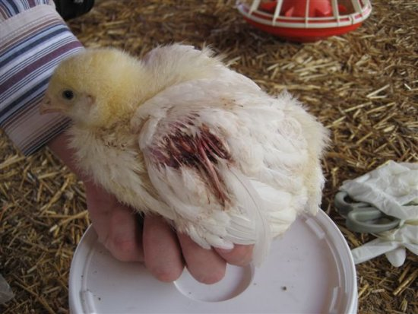
Haemorrhages on the wing of a young chicken with Chicken Infectious Anemia, hence the name Blue Wing Disease.

Slide 50
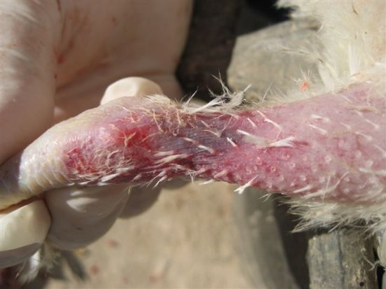
Subcutaneous haemorrhage in a young chicken with Chicken Infectious Anemia, resulting in blue discoloration of the hock joint.

Slide 51
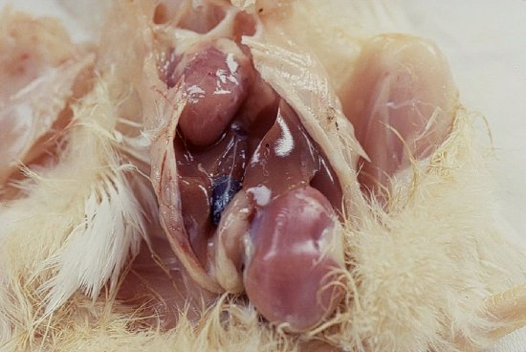
Pale anemic carcass of a young chicken with Chicken Infectious Anemia

Slide 52
Diagnosis
Diagnosis of chicken anemia virus infection in chickens is based on history, clinical signs, and gross and microscopic pathologic findings.
Anemia, leukocytopenia, and thrombocytopenia.
Packed cell volumes are low, and blood smears often reveal anemia and leukopenia.
Blood may be watery and clot slowly as a consequence of thrombocytopenia.

Slide 53
Diagnosis
Laboratory tests
Laboratory tests to identify the viral genome, antigen or antibodies are required for a definitive diagnosis.
Testing serum samples for example at the time of the clinical signs and 2-3 weeks later provide the best basis for serological diagnosis.
Chicken anemia virus is the only avian gyrovirus that can be efficiently propagated in cell culture, specifically in lymphoblastoid T cell (MDCC-MSB1 and MDCC-JP2) and B cell lines (LSCC-1104B1)
Notes:
Mareks disease chicken cell line (MDCC)
Leucocyte subset cell culture (LSCC)

Slide 54
No specific treatment is available. Control is best achieved by vaccination.
Chicken anemia virus poses no known zoonotic risk to humans, nor does it infect other mammals.

Slide 55
Porcine circovirus (PCV)
Common virus of pigs found throughout the world
The smallest virus to infect mammals
Two porcine circoviruses have been isolated from pigs.
Porcine circovirus 1 (PCV1) is ubiquitous, and nonpathogenic in swine.
Porcine circovirus 2 (PCV2) emerged as a major swine pathogen about 20 years ago and is now endemic worldwide.
PCV2 is associated with postweaning multisystemic wasting syndrome (PMWS), a disease characterized by jaundice, diarrhea, respiratory disease, failure to thrive, and sudden death.

